Slide 1
Update
Olivier Bergeron

Slide 2
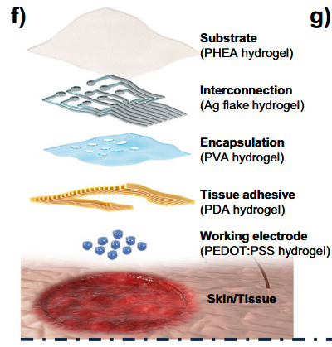
Literature review
“Emerging roles of hydrogels, organogels, and their hybrids in soft bioelectronics and bioplatforms”
Did not take the time for a full review

Slide 3
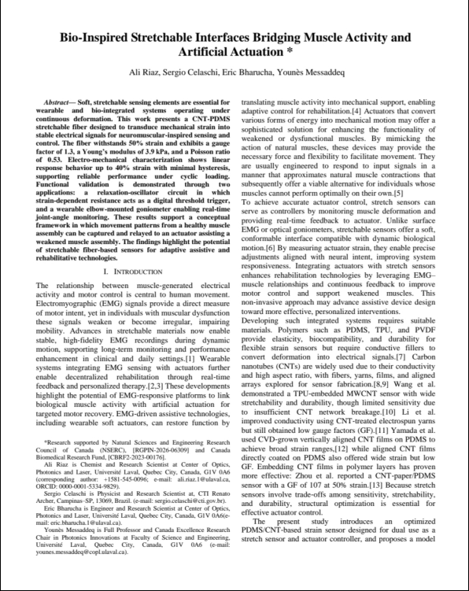
Electrode sample - COPL
In communication with someone at COPL
Still in communication to understand more about their experience

Slide 4
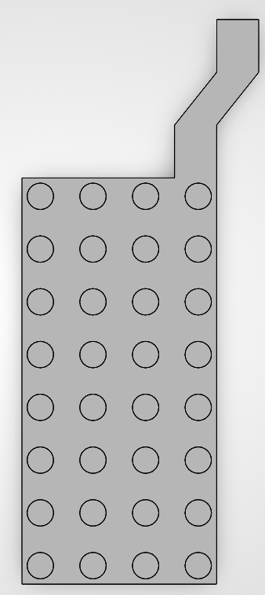
Microneedle sample
Started the schematics
In communication with Kazim (Calgary)
Will probably need help with some stuff later
2.5 mm

Slide 5
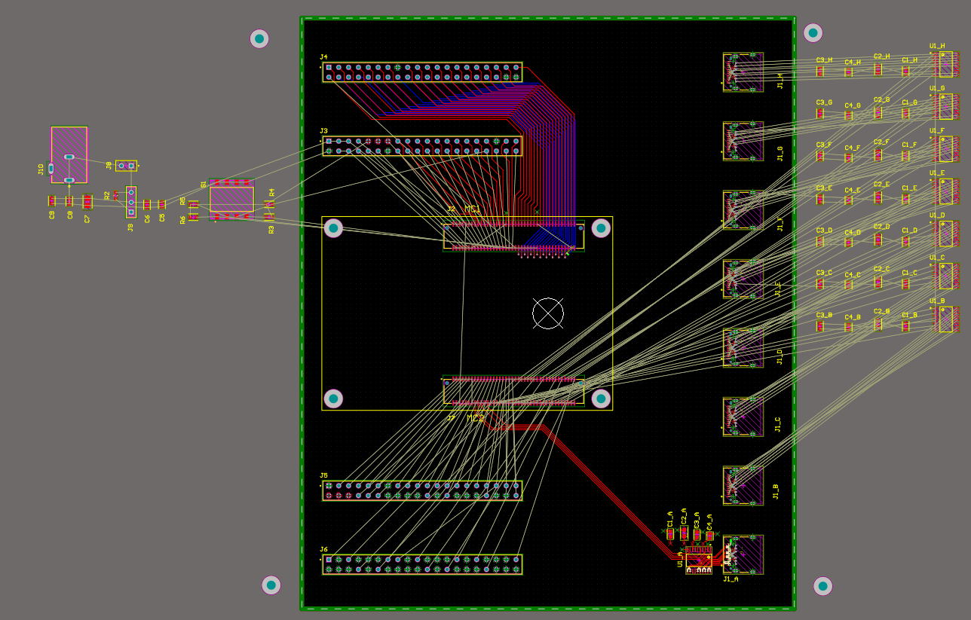
Breakout board
Component placement & routing in progress
Goal: Have it done during the next 2 weeks

Slide 6
To Do list
Finish breakout board
Keep working on the microneedle sample
Communicate with COPL for more details
Read on some articles

